Slide 1
Testing/Validation Activities Unit-IV
Prepared by: Neha Tripathi

Slide 2
Unit Testing

Slide 3
Introduction
By validation, we mean that the module that has been prepared till now is in conformance with the requirements which were set initially in the SRS or user manual.
Software validation is achieved through a series of black-box tests that demonstrate conformity with requirements.
A test plan outlines the classes of tests to be conducted.
A test procedure defines specific test cases that will be used to demonstrate conformity with requirements.
Both the plan and procedure are designed to ensure that all functional requirements are satisfied, all behavioural characteristics are achieved, all performance requirements are attained, documentation is correct and human-engineered, and other requirements are met.

Slide 4
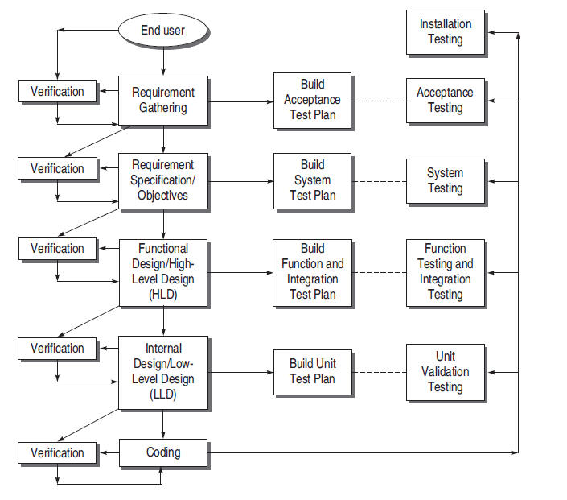
V & V Activities

Slide 5
continue….
As shown in the diagram, every validation testing focuses on a particular SDLC phase and thereby focuses on a particular class of errors.
We can see a one-to-one correspondence between development and testing processes.
The advantage of this structure of validation testing is that it avoids redundant testing and prevents one from overlooking large classes of errors. For example,
The purpose of unit validation testing is to find discrepancies between the developed module’s functionality and its requirements and interfaces specified in the SRS.
The purpose of system validation testing is to explore whether the product is consistent with its original objectives.

Slide 6
Validation Testing Techniques
UNIT VALIDATION TESTING
INTEGRATION TESTING
- DECOMPOSITION-BASED INTEGRATION
- non-incremental (big-bang testing)
- incremental
- Top-down Integration Testing(Depth first integration and Breadth first integration)
- Bottom-up Integration Testing
- Sandwich Integration Testing.
- CALL GRAPH-BASED INTEGRATION
- Pair-wise Integration
- Neighbourhood Integration
- PATH-BASED INTEGRATION
FUNCTION TESTING
SYSTEM TESTING (Security testing, Stress testing, Performance testing, Compatibility testing, Recovery testing, Load testing, Usability testing)
ACCEPTANCE TESTING (alpha testing and beta testing)

Slide 7
UNIT VALIDATION TESTING
Before we validate the entire software, units or modules must be validated.
Unit is the smallest building block of the software system i.e., module
Unit tests ensure that the software meets at least a baseline level of functionality prior to integration and system testing
Unit testing is normally considered adjunct to the coding step. However, it has been discussed that testing with the code of a unit is called the verification step.
Units must also be validated to ensure that every unit of software has been built in the right manner in conformance with user requirements.
While developing the software, if the developer detects and removes the bug, it offers significant savings of time and costs.
Unit testing is largely based on black-box techniques.

Slide 8
Unit Test Environment
Though software is divided into modules but a module is not an isolated entity.
The module under consideration might be getting some inputs from another module or the module is calling some other module. It means that a module is not independent and cannot be tested in isolation.
While testing the module, all its interfaces must be simulated if the interfaced modules are not ready at the time of testing the module under consideration.
The types of interface modules which must be simulated, if required , to test a module are:
- Drivers
- Stubs

Slide 9
continue….
Drivers
-Suppose a module is to be tested, wherein some inputs are to be received from another module. However, this module which passes inputs to the module to be tested is not ready and under development. In such a situation, we need to simulate the inputs required in the module to be tested.
-For this purpose, a main program is prepared, wherein the required inputs are either hard-coded or entered by the user and passed on to the module under test.
-This module where the required inputs for the module under test are simulated for the purpose of module or unit testing is known as a driver module.

Slide 10
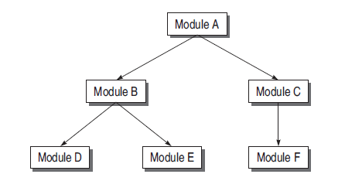
For example, see the design hierarchy of the modules .

Slide 11
continue….
Suppose module B is under test. In the hierarchy, module A is a super-ordinate of module B. Suppose module A is not ready and B has to be unit tested. In this case, module B needs inputs from module A. Therefore, a driver module is needed which will simulate module A in the sense that it passes the required inputs to module B and acts as a main program for module B in which its being called, shown in next fig.

Slide 12
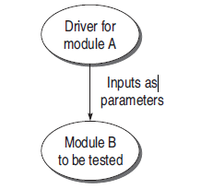
Driver Module for module A

Slide 13
Characteristics of a driver module
A driver can be defined as a software module which is used to invoke a module under test and provide test inputs, control and monitor execution, and report test results or most simplistically a line of code that calls a method and passes a value to that method.
A test driver may take inputs in the following form and call the unit to be tested:
- It may hard-code the inputs as parameters of the calling unit.
- It may take the inputs from the user.
- It may read the inputs from a file.
A test driver provides the following facilities to a unit to be tested:
- Initializes the environment desired for testing.
-Provides simulated inputs in the required format to the units to be tested.

Slide 14
Stubs
The module under testing may also call some other module which is not ready at the time of testing. Therefore, these modules need to be simulated for testing.
In most cases, dummy modules instead of actual modules, which are not ready, are prepared for these subordinate modules. These dummy modules are called stubs.
A stub can be defined as a piece of software that works similar to a unit which is referenced by the unit being tested, but it is much simpler than the actual unit.
A stub works as a ‘stand-in’ for the subordinate unit and provides the minimum required behaviour for that unit.

Slide 15
For example, see the design hierarchy of the modules

Slide 16
continue…..
Module B under test needs to call module D and module E. But they are not ready. So there must be some skeletal structure in their place so that they act as dummy modules in place of the actual modules. Therefore, stubs are designed for module D and module E, as shown in next fig.

Slide 17
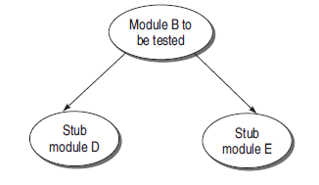
Stub module for module B

Slide 18
Characteristics of a stub module
Stub is a place holder for the actual module to be called. Therefore, it is not designed with the functionalities performed by the actual module. It is a reduced implementation of the actual module.
It does not perform any action of its own and returns to the calling unit (which is being tested).
We may include a display instruction as a trace message in the body of stub. The idea is that the module to be called is working fine by accepting the input parameters.
A constant or null must be returned from the body of stub to the calling module.
Stub may simulate exceptions or abnormal conditions, if required.

Slide 19
Benefits of Designing Stubs and Drivers
Stubs allow the programmer to call a method in the code being developed ,even if the method does not have the desired behaviour yet.
By using stubs and drivers effectively, we can cut down our total debugging and testing time by testing small parts of a program individually, helping us to narrow down problems before they expand.
Stubs and drivers can also be an effective tool for demonstrating progress in a business environment.
However, drivers and stubs represent overheads also. Overhead of designing them may increase the time and cost of the entire software system. Therefore, they must be designed simple to keep overheads low.

Slide 20
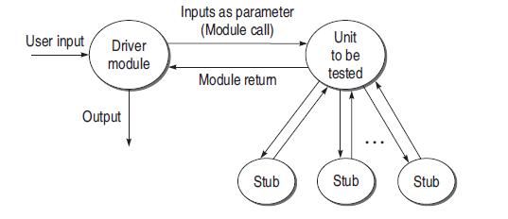
Drivers and Stubs

Slide 21
Example
Consider the following program:
main()
{
int a,b,c,sum,diff,mul;
scanf(“%d %d %d”, &a, &b, &c);
sum = calsum(a,b,c);
diff = caldiff(a,b,c);
mul = calmul(a,b,c);
printf(“%d %d %d”, sum, diff, mul);
}
calsum(int x, int y, int z)
{
int d;
d = x + y + z;
return(d);
}

Slide 22
Questions
(a) Suppose main() module is not ready for the testing of calsum() module. Design a driver module for main().
(b) Modules caldiff() and calmul() are not ready when called in main().Design stubs for these two modules.

Slide 23
Solutions
(a) Driver for main() module:
main()
{
int a, b, c, sum;
scanf(“%d %d %d”, &a, &b, &c);
sum = calsum(a,b,c);
printf(“The output from calsum module is %d”, sum);
}

Slide 24
Solutions
(b) Stub for caldiff() Module
caldiff(int x, int y, int z)
{
printf(“Difference calculating module”);
return 0;
}
Stub for calmul() Module
calmul(int x, int y, int z)
{
printf(“Multiplication calculation module”);
return 0;
}

